Slide 1


2019 Tax Return Information For Mr. & Mrs. Smith
By: Gil Benamor
Tax4001
August 26^{th, 2020}

Slide 2

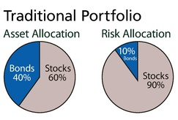
Investment opportunities
Corporate bonds: Delivers decent returns with lower risk than stocks.
High-dividend stocks: Presents a possibility of high returns with greater risk.
Municipal (muni) bonds: Yields in lower rate of return, but has virtually zero risk. Investing in Muni bonds also helps to build upon your city or state..
This Photo by Unknown Author is licensed under CC BY-SA

Slide 3

Municipal Bonds
General Obligation Muni Bonds
Revenue Muni Bonds
Bonds that repay their share holders through taxes with low interest rates.
Limited and unlimited tax general obligation bonds
Unlimited tax can often use sales taxes, property taxes, etc. to repay bonds, as well as interest owed to investors
Example-
A town might pass a bond to build a bridge and agree to a one cent increase in sales tax for every $1 generated within the city limits for 5 years to pay for the debt. (Limitied)
Generates capital through ticket sales, bills, tolls, etc.
These bonds are issued by municipality and is backed by a specific stream of revenue.
Pays to build city stadiums, convention centers, airports, etc.
Builds infrastructure for your city
This Photo by Unknown Author is licensed under CC BY-ND

Slide 4

Tax strategies
Conversion strategy
Implicit taxes
This strategy exploits the changes in taxation across different activities.
Pertains to investment planning and the benefits of investing in assets with preferential taxed income.
These taxes increase the costs associated with the activities that are supported by tax advantages, which reduced the advantages of the conversion strategy.
May lessen municipal bond investments by lowering pre-tax rate of return on investment.
This Photo by Unknown Author is licensed under CC BY-NC-ND

Slide 5
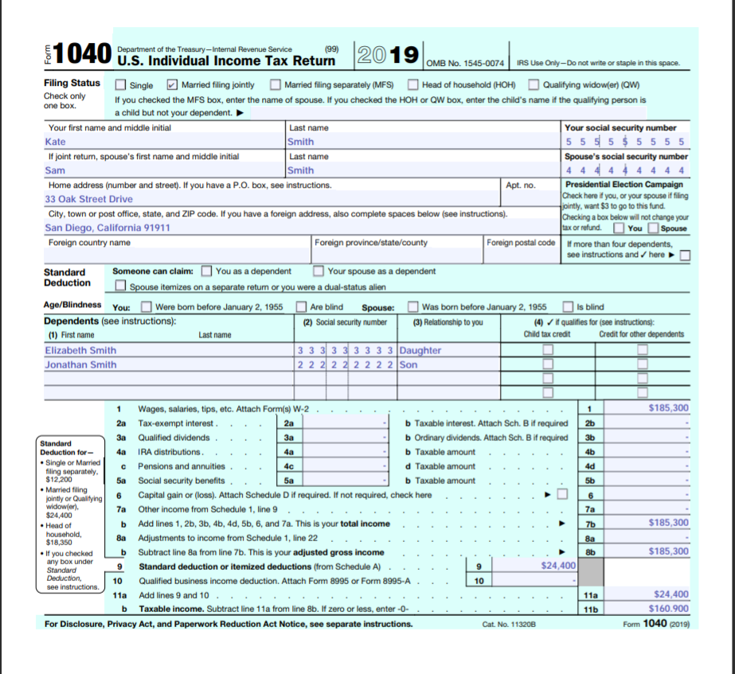
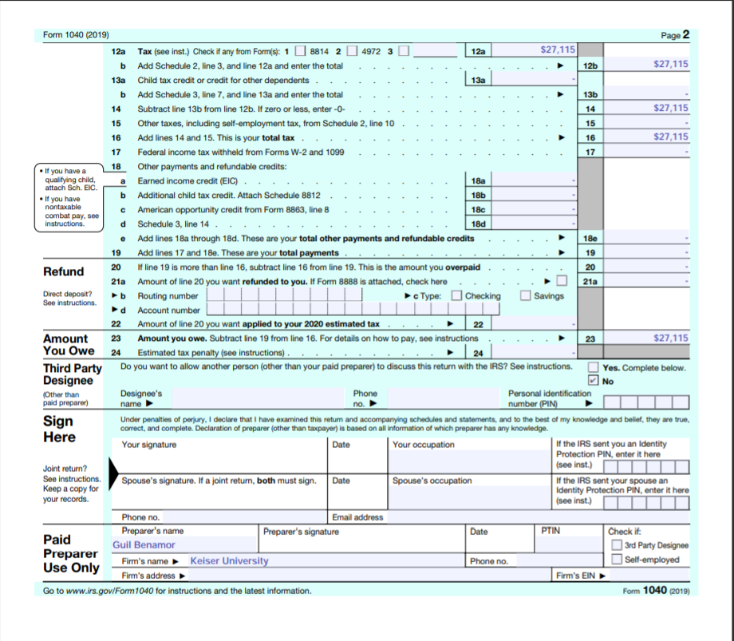
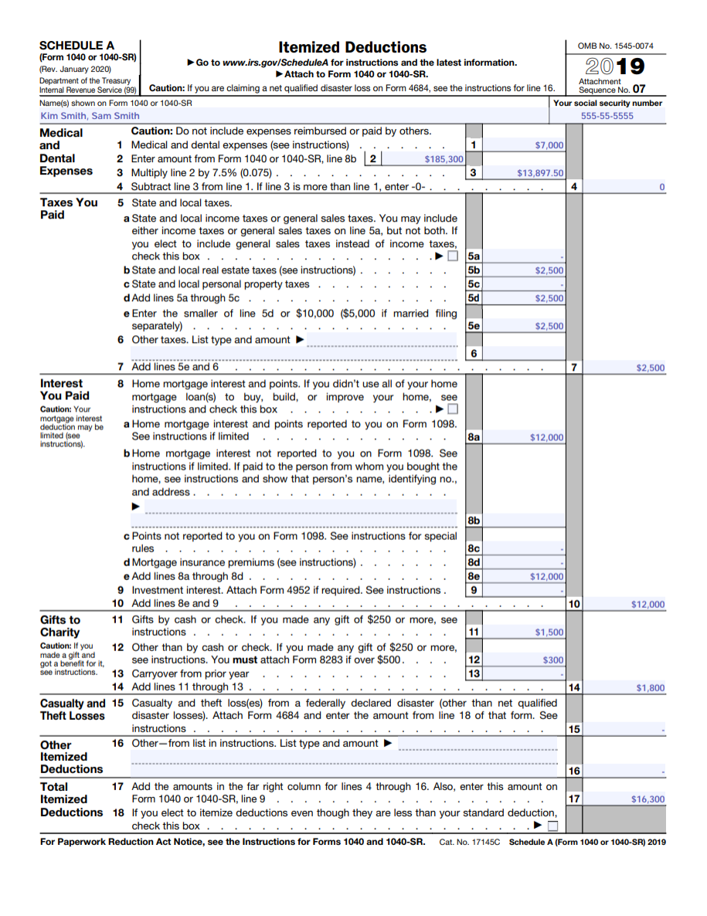
Form 1040 and Schedule A
Form1040- This is the necessary form for U.S. taxpayers to file an annual income tax return.
Schedule A- This form is an extension of form 1040, that figures your itemized deductions.

Slide 6
Itemized Deductions or Standard deduction
Standard: A fixed amount of deductions that lowers your taxable income.
Itemized: Deductions that are made up of a list of eligible expenses
Deductible:
-Home interest $12,000
-Real estate tax $2,500
-Charitable contributions $1,800
Non-Deductible:
-Medical expenses (due to higher AGI than threshold)
-Moving expenses
-Student Loan Interest
-Personal credit card interest
-Union dues
-Tax preparation fees

Slide 7
Form 1040

Slide 8
1040 (Continued)
1) First Step: figure out your adjusted gross income (AGI)
    [Gross income – Deductions] $185,300 - $24,400 = $160,900 = Taxable Income.
2) Second Step: apply the tax rate ( provided by the IRS) to your taxable income
    ([$160,900 - $78,950] x22%)+ $9,086= $27,115 = Tax Liability for the year (what you owe).
3) Third Step: fill out any other information like credits
    You do not qualify for any credits
4) Last Step; Identify if you owe taxes, or earn a return

Slide 9
References
Fuscaldo, D. (2020, February 19). Tax Deductions for Vacation Homes. Retrieved August 22, 2020, from https://www.houselogic.com/finances-taxes/taxes/tax-deductions-vacation-homes/
Kathy Pickering Chief Tax Officer (2020, July 09). Tax Cuts & Jobs Act (TCJA): H&R Block. Retrieved August 21, 2020, from https://www.hrblock.com/tax-center/irs/tax-reform/tax-cuts-and-jobs-act
Kennon, J. (2019, July 15). Get to Know the Two Big Categories of Municipal Bonds. Retrieved August 21, 2020, from https://www.thebalance.com/general-obligation-vs-revenue-municipal-bonds-357926
Spilker, B. C., Outslay, E., Ayers, B. C., Barrick, J. A., Robinson, J. R., & Worsham, R. G. (2020). McGraw-Hill's taxation of individuals. New York, NY: Mcgraw-Hill Education.

